Slide 1
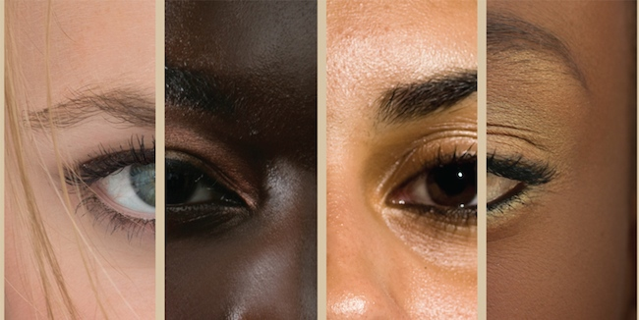
Eugene Ellis
Finding Our Voice
Big Conversations:
Race, Trauma & Collective Healing - 20 January 23

Slide 2

Themes
Why is it so hard to talk about race?
Core ideas for moving towards finding your voice

Slide 3


Slide 4

Notes:
Forum Experiences

Slide 5
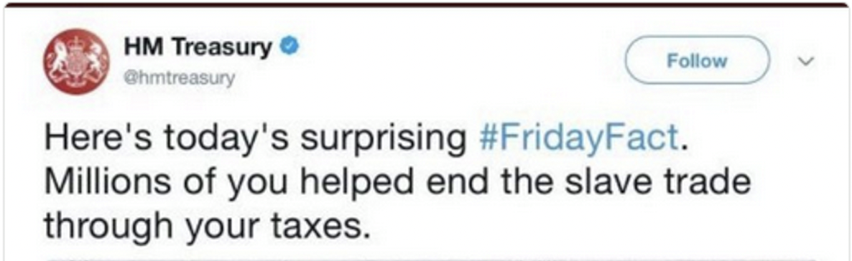
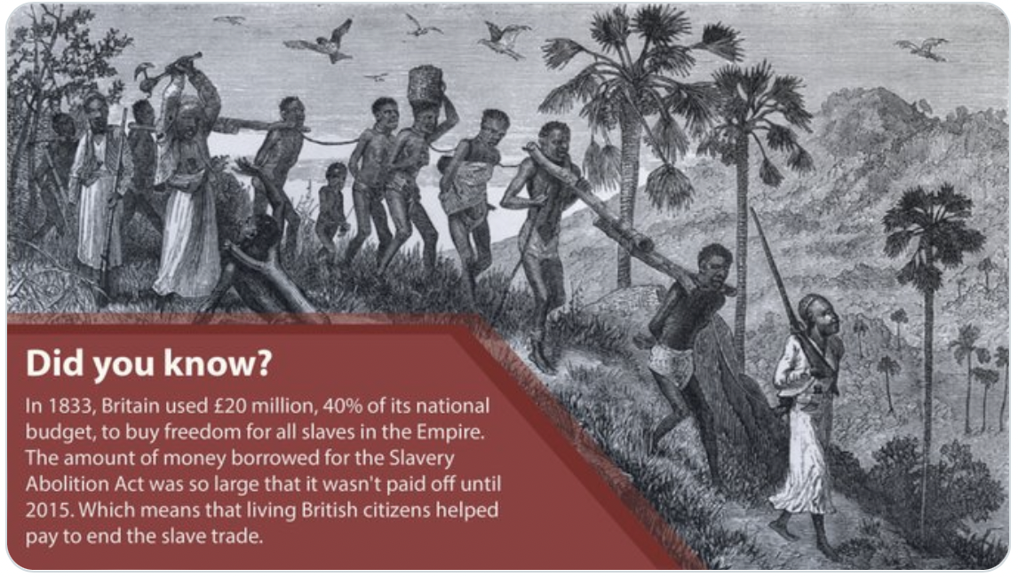

Slide 6
UK and US
US
Median net worth of households in US
  $184,000 white family
  $23,000 black family (An 8th of the typical wealth held by a white family)
  $38,000 Hispanic family (A 5th of the typical wealth held by a white family)
Federal Reserve’s Survey of Consumer Finances, the Brookings Institution - 2019
Ellis, 2021
Notes:
Recognition Trauma - Race Construct Arousal
Race contruct - Ancestral baggage)

Slide 7
UK and US
UK
Median family wealth per adult in UK
  £197,000 - white British
  £24,000 - black, African (an 8th of the typical wealth held by a white British family)
  £31,000 - Bangladeshi (a 6th of the typical wealth held by a white British family)
  £42,000 - mixed white and Black Caribbean (a 6th of the typical wealth held by a white British family)
The Resolution Foundation Briefing 2020 - A gap that won’t close
Ellis, 2021
Notes:
Recognition Trauma - Race Construct Arousal
Race contruct - Ancestral baggage)

Slide 8
UK and US
US
The US has a black population of 13.5% and a prison population of 39%
  The prison population is 2.9 times more than the actual population
Census of State and Federal Adult Correctional Facilities, 2019 - U.S. Department of Justice
US Census
Ellis, 2021
Notes:
Recognition Trauma - Race Construct Arousal
Race contruct - Ancestral baggage)

Slide 9
UK and US
UK
The UK has a black population of 3% and a prison population of 13%
  The prison population is 4.3 times more than the actual population
Ethnicity and the criminal justice system statistics 2020 - UK Ministry of Justice
Ellis, 2021
Notes:
Recognition Trauma - Race Construct Arousal
Race contruct - Ancestral baggage)

Slide 10


RACE TRAUMA

Slide 11
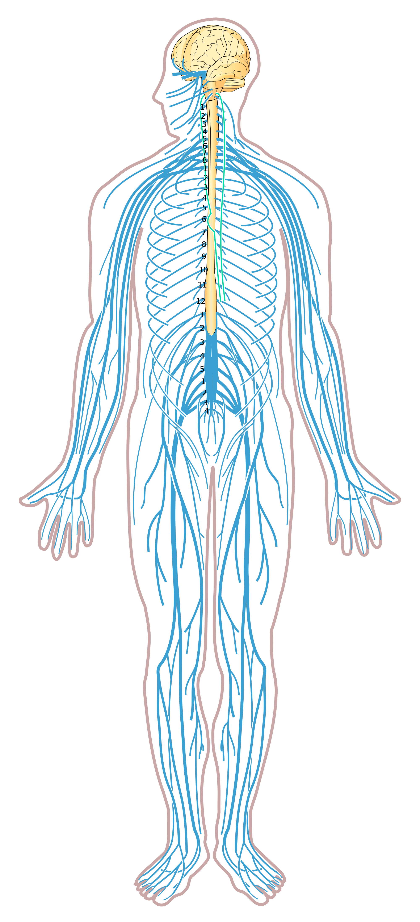
The embodiment of race
Unconscious historical information (implicit memory) is stored in all of our bodies which reveals itself mostly outside of our awareness.
In the presence of race, we play out our assigned roles based on our assigned racial identity, non-verbally and mostly unconsciously.

Slide 12
Pause
What is happening in your body?

Slide 13
“it is easy to forget how mysterious and mighty stories are. They do their work in silence, invisibly... beware the stories you read or tell; subtly, at night, beneath the waters of consciousness, they are altering our world”
– Ben Okri - A way of Being Free, 2015

Slide 14


Slide 15

Image of two faces

Slide 16
The paradigm shift
Recognising there is unconscious material present when race becomes foreground (Generational loading)
Understanding that there is a measure of distress and feeling physiologically unsafe in becoming conscious (Race Construct Arousal)
Ellis, 2021
Notes:
Recognition Trauma - Race Construct Arousal
Race contruct - Ancestral baggage)

Slide 17
Race Construct Awareness
Becoming more competent/comfortable navigating the race construct over time.
Staying curious, recognising our defences, mindfully listening to the body, bringing awareness to what is happening in the present moment - in the spirit of compassion and a sense of shared suffering.
Ellis, 2021
Notes:
Recognition Trauma - Race Construct Arousal
Race contruct - Ancestral baggage)

Slide 18
Compassion
“Compassion is not just a cognitive function; it also has this implicit level of acknowledging and witnessing without reacting”
Stephen Porges
Notes:
The development of compassion

Slide 19

Celia
Notes:
Grew up in Apartide South Africa
She attended one of the trainings that we offer
Talks about her personal journey and overcoming her fear around the race conversation.
(noted that she spoke about Compassion)
You expereince more flexiblility moving between saftey vs exploration
There is an experience of letting go
Having an overall awareness of staying in contact with the hurt that the race construct inflicts on both sides of the black/white divide.
A recognition that defenses will be there and to meet them with compassion for ourselves.

Slide 20

Karnac books
free delivery worldwide:
20% off Code: RACE20 - Expiry date: 31st January 2023.
https://www.karnacbooks.com/product/the-race-conversation-an-essential-guide-to-creating-life-changing-dialogue/95399/

Slide 21



Contact details
    www.baatn.org.uk
    info@eugeneellis.co.uk
    facebook.com/baatn/
    twitter.com/baatn_network
    instagram.com/baatn_network/

Slide 22
Resources
Videos
  Decolonizing Education: Let’s talk about it - https://www.youtube.com/channel/UCDdxymR51rGAkE8AbnmbOlg/featured
  What does it mean to be white in a society that proclaims race meaningless? Robin DiAngelo - https://www.youtube.com/watch?v=_A-pZH-S4jk
  Pran Patel's Decolonise the Curriculum Ted Talk https://youtu.be/8JjRQTuzqTU
  Pran Patel's Decolonise the Curriculum companion article https://theteacherist.com/2019/05/26/decolonise-the-curriculum/
  Witnessing the wound - 20 min video complied by Eugene Ellis, BAATN. https://vimeo.com/262194819

Slide 23
Resources cont
Books
  Ellis, Eugene. The Race Conversation: An Essential Guide to Creating Life-Changing Dialogue. Confer Books, 2021.
  Dalal, Farhad. Thought Paralysis: The Virtues of Discrimination. London: Karnac Books, 2012.
  Keval, Narendra. Racist States of Mind. 1 edition. Routledge, 2016.
  Overcoming Everyday Racism: Building Resilience and Wellbeing in the Face of Discrimination and Microaggressions, Susan Cousins 2019
  McKenzie-Mavinga, Isha. The Challenge of Racism in Therapeutic Practice: Engaging with Oppression in Practice and Supervision. 2nd ed. 2016 edition. Palgrave, 2016.

Slide 24
Resources cont
Article
  4 Ways White People Can Process Their Emotions Without Hijacking the Conversation on Racial Justice: Radical self love for everybody and every body - Jennifer Loubriel https://thebodyisnotanapology.com/magazine/4-ways-white-people-can-process-their-emotions-without-bringing-the-white-tears/
On Demand presentations with Eugene Ellis
  The Race Conversation: Finding a Voice https://www.confer.uk.com/on-demand-events/race.html
  Post-Slavery Syndrome: Exploring The Clinical Impact Of The Trans-Atlantic Slave Trade - https://www.confer.uk.com/module/module-slavery.html

